Slide 1
An Introduction to Web Design and Development: Environment and Tools

Slide 2
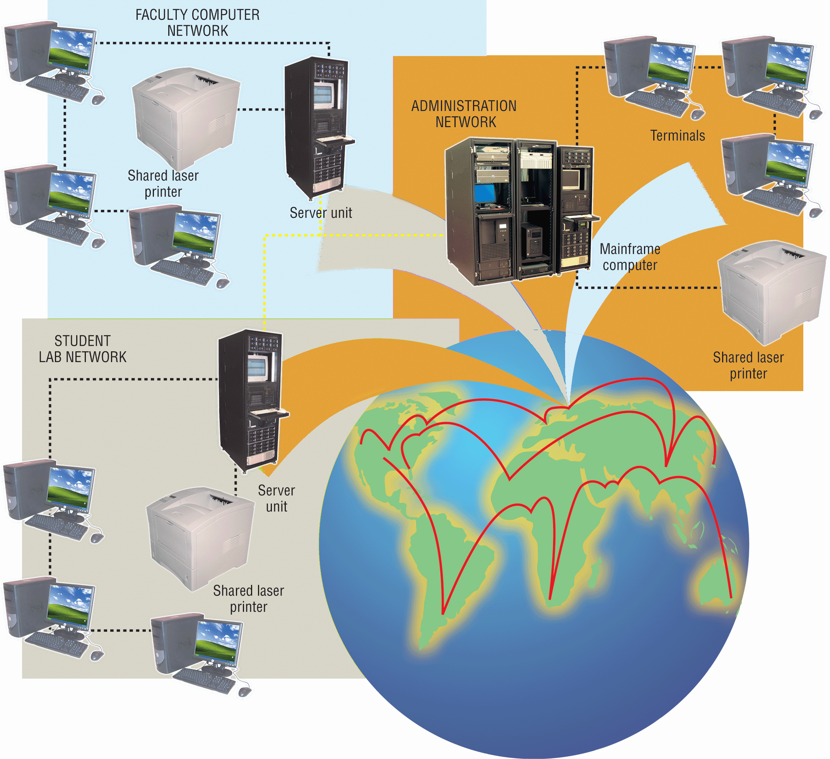
The Internet and the World Wide Web
The Internet is a worldwide collection of networks, each of which is composed of a collection of smaller networks
A network is composed of several computers connected together to share resources and data

Slide 3
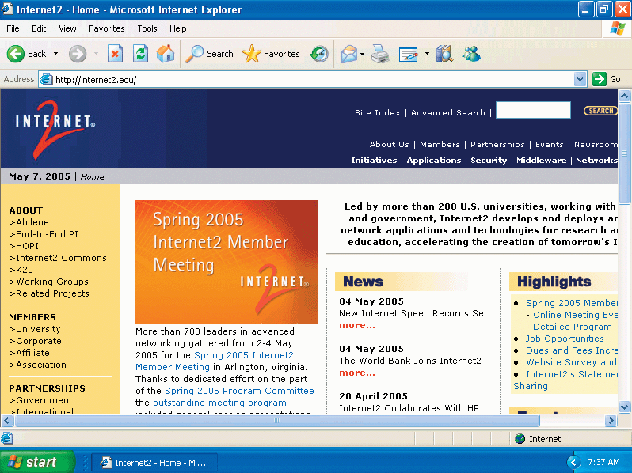
The Internet and the World Wide Web
Internet 2 is a major cooperative initiative among academia, industry, and the government to increase the Internet’s possibilities and correct some of its challenges
Bottlenecking

Slide 4
The Internet and the World Wide Web
The World Wide Web (WWW or Web) is a graphical interface that utilizes the Internet to distribute and retrieve information
A Web site is a collection of linked Web pages
Starts with a home page
Pages are linked together with a hyperlink, or link
Surfing the Web

Slide 5
Accessing Information on the Web
Users access Web sites through the public switched telephone network
Worldwide telephone system that handles voice-oriented phone calls
Integral part of computer communications
Network mostly uses digital technology

Slide 6
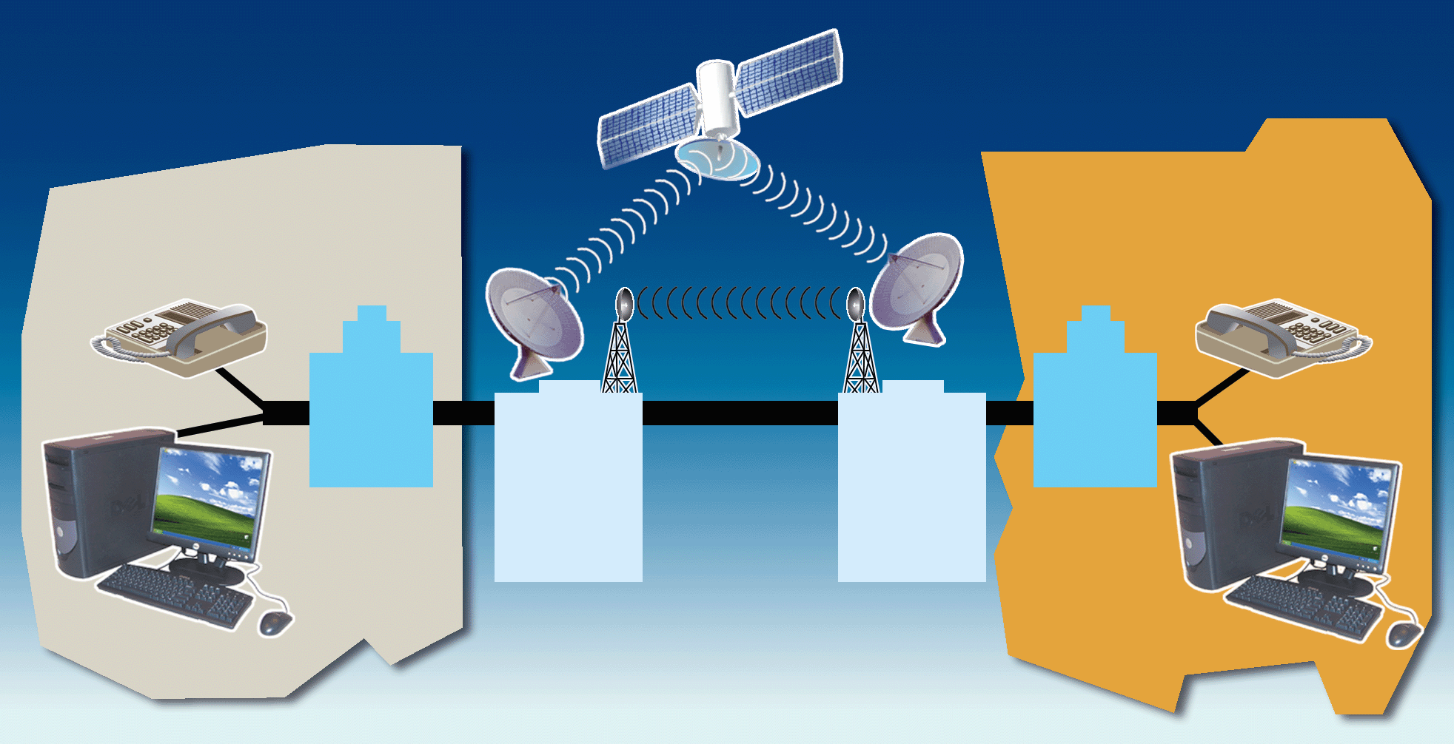
Accessing Information on the Web
local access area
local access area
local
telephone
company
local
telephone
company
long- distance telephone company
long- distance telephone company
telephone service customer
telephone service customer

Slide 7
Dial-Up Lines
A dial-up line is a temporary connection that uses one or more analog phone lines
Requires a modem on each end of the connection
Communication ends when either modem hangs up

Slide 8
Dial-Up Lines
Advantages
Cost. Costs no more than a regular phone call
Availability. Computers at any two locations can establish a connection using a modem and telephone network
No Contracts. New dial-up subscribers typically do not have to enter into a contract. Broadband providers, on the other hand, often require a contract of 12 months or longer for the special rates offered to new customers.
Changing Service Hassles. Having to change ISPs and add extra equipment for broadband simply is not appealing to Internet users, who only connect occasionally for e-mail and very limited web surfing.

Slide 9
Dial Up Lines
Disadvantages
Cannot control quality of connection
Slow transfer rates
Requires phone lines

Slide 10
Dedicated Lines
A dedicated line is a connection that always is established between two communications devices
Can be analog or digital
Quality, consistency, and speed of the connection are better than a dial-up line
Businesses often use dedicated lines

Slide 11
Dedicated Lines
Three popular types of digital dedicated lines
ISDN lines
Digital Subscriber Lines
T-carrier Lines

Slide 12
ISDN Lines
Integrated Services Digital Network
ISDN allows a single telephone line to carry three or more signals (multiplexing)
Faster than dial-up
ISDN emerged as an alternative to traditional dialup networking during the 1990s.

Slide 13
DSL
Digital Subscriber Line
Transmits at fast speeds on existing standard copper telephone wiring
Some installations can also provide a dial tone
Asymmetric Digital Subscriber Line (ADSL)
Faster to receive data than to send data
Ideal for Internet users

Slide 14
T-carrier Lines
Any of several types of digital lines that carry multiple signals over a single communications line
Extremely fast data transfer rates

Slide 15
T-carrier Lines – T1 Lines
T1 Line
Most popular T-carrier line
Can be copper or fiber optic cable
can carry 24 digitized voice channels, or it can
carry data at a rate of 1.544 megabits per second.
Fractional T1

Slide 16
T-carrier Lines – T3 Lines
T3 Line
- a common aggregation of 28 T1 circuits that yields 44.736 Mbps total network bandwidth.
- Besides being used for long-distance traffic, T3 lines are also often used to build the core of a business network at its headquarters.
- A T3 line typically costs more than $3000 USD per month.
Other Circuits
- The concept of T2, T4 and T5 aggregated lines also exist in telecommunications, but these are much less commonly used in practice.

Slide 17
Cable Television Lines
Allows users to connect to the Internet through their cable line
Rapid transfer rates using a cable modem connected to a CATV line

Slide 18
Fixed Wireless
Internet connectivity for users who do not have access to services such as DSL or cable
Satellite technology used instead of telephone lines
Radio signals provide high-speed connection

Slide 19
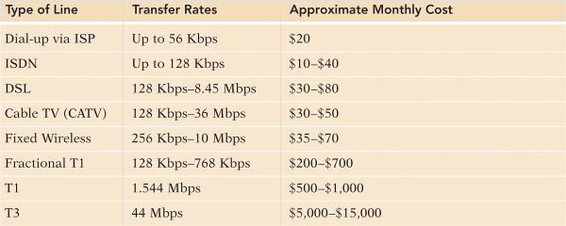
Dedicated Lines
A transfer rate is the speed at which a line carries data and information
Measured in bits per second (bps)
Kbps
Mbps
OC3 - 155 megabits per second (84 T1s)
OC12 - 622 megabits per second (4 OC3s)
OC48 - 2.5 gigabits per seconds (4 OC12s)
OC192 - 9.6 gigabits per second (4 OC48s)

Slide 20
Selecting a Service Provider
Internet Service Provider (ISP)
Is a company or organization that provides temporary connections free or for a fee

Slide 21
Service Providers
Online Service Provider (OSP)
Supplies Internet access and members-only features
News, weather, financial data, games, travel guides
America Online and The Microsoft Network
Fees are slightly higher for an OSP than ISP

Slide 22
Service Providers
Wireless Service Provider (WSP)
Company that provides wireless Internet access to users with wireless modems or Web-enabled handheld computers or devices
AT&T Wireless, SprintPCS
Bluetooth is a short-range wireless connection that utilizes radio frequency to transmit data between two electronic devices

Slide 23
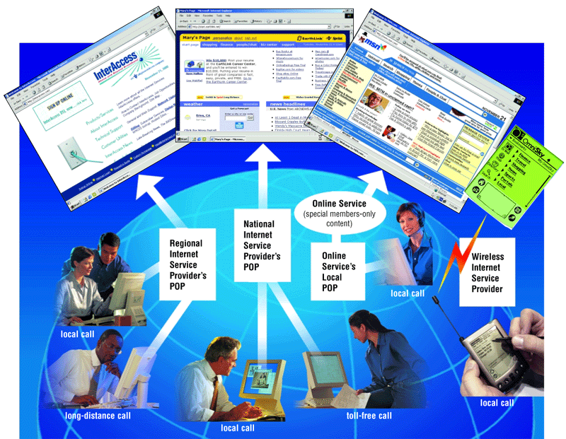
Service Providers

Slide 24
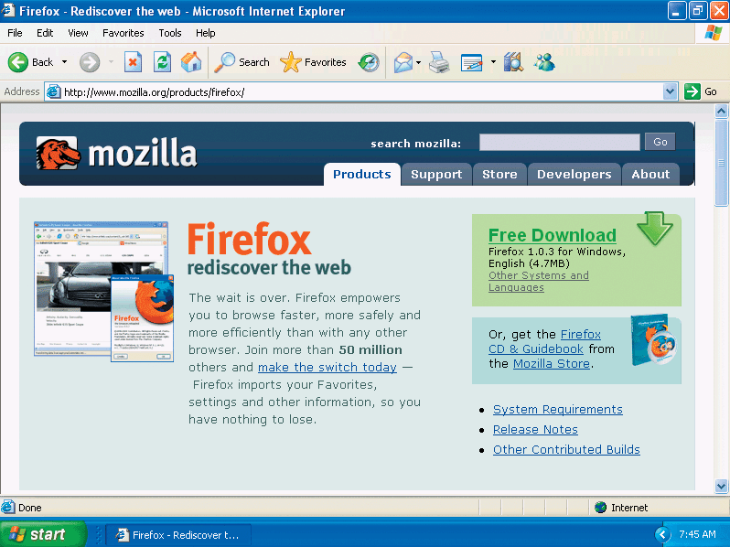
Web Browsers
A Web browser is a specific software program required to display Web pages

Slide 25
Web Browsers
Access Web pages by entering its Uniform Resource Locator (URL) into the Web browser’s address bar
URL is comprised of the protocol, followed by the domain name
Hypertext Transfer Protocol
Domain name can be an IP address or a text version of this address

Slide 26
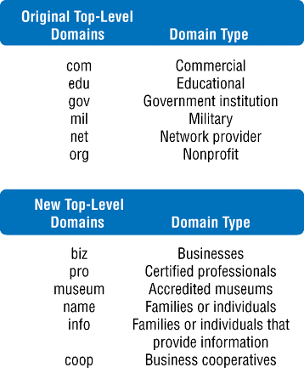
Web Browsers
protocol
domain name
http://pucinfo.calumet.purdue.edu
http://205.216.71.230
IP address
protocol

Slide 27


Alternative Web Page Viewing Devices
Smart phones
Can be used as a regular cell phone and offer e-mail and Web access
Handheld computers
Wireless, portable computers designed to fit in a user’s hand
Personal Digital Assistant (PDA)

Slide 28
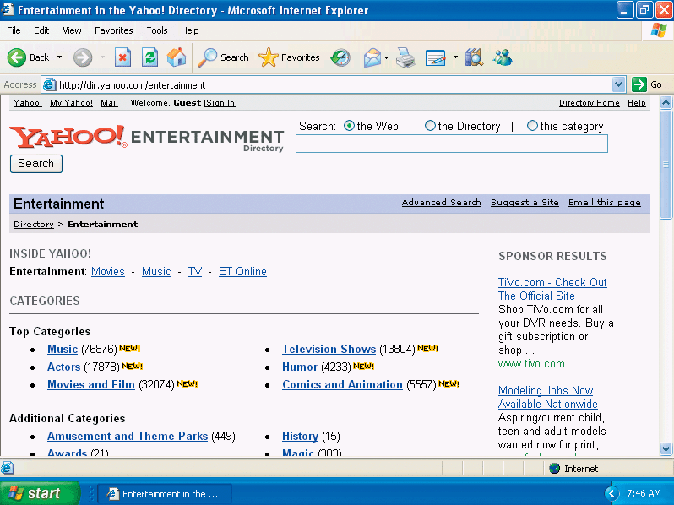
Search Engines / Portals
Software programs that find Web sites and Web pages
Enter a keyword into a search engine’s text box to locate a Web page about a particular topic
Directories classify Web pages into various categories

Slide 29
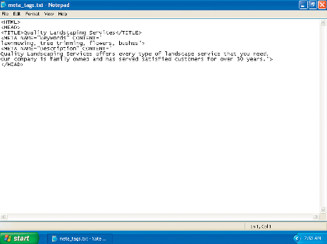
Search Engines / Portals
Search services create their own Web site databases in different ways
Spiders or robots
Meta tags
Special tags added to Web pages containing information on content

Slide 30
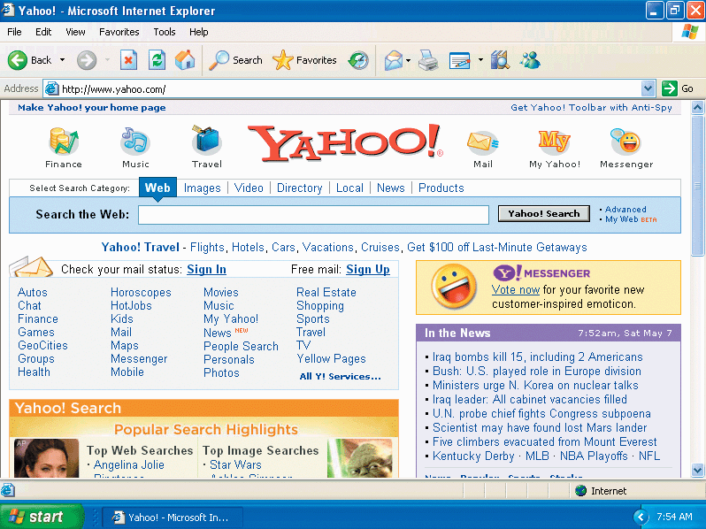
Search Engines / Portals
Portals are web sites that offer more than just search services
E-mail, chat rooms, news and sports, etc.
Google, MSN, and Yahoo!

Slide 31
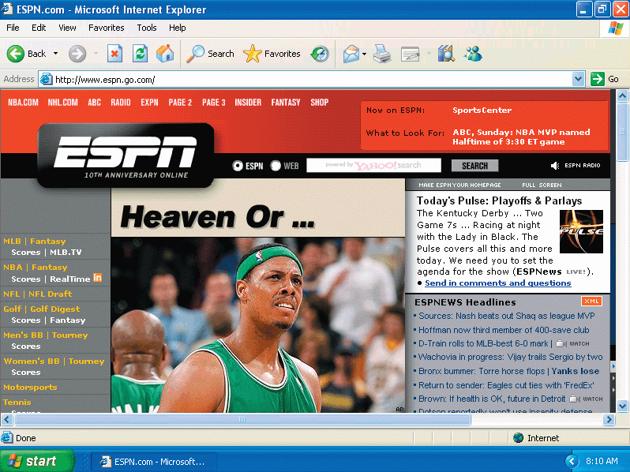
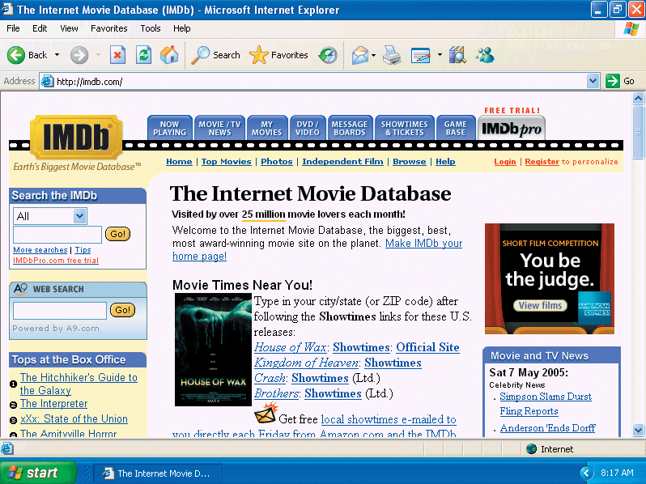
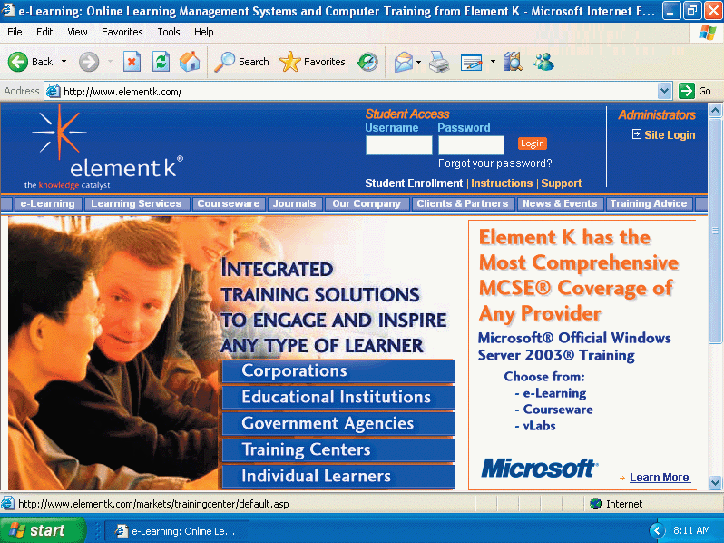
Impact of the Internet and the Web
Communication
Education
Entertainment
Business

Slide 32
Communication
Email
Transfers messages and files
Message can be communicated positively or negatively
Web sites
Delivers messages successfully and persuasively
Site design requires much planning
Trustworthiness, currency, and value

Slide 33
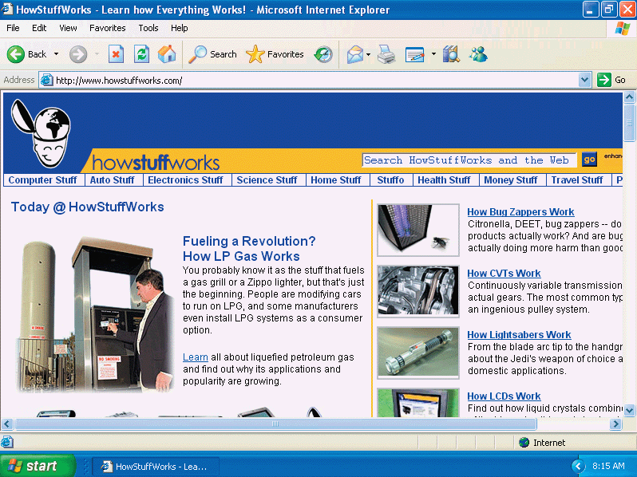
Education
Formal and informal teaching and learning
Enhances traditional teaching methods
Instructors often publish syllabi, grades, and helpful information for research

Slide 34
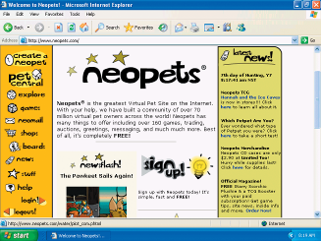
Entertainment
Entertainment web sites include music, videos, sports, games, and more
It is important to identify what would appeal to your audience when developing an entertainment element

Slide 35
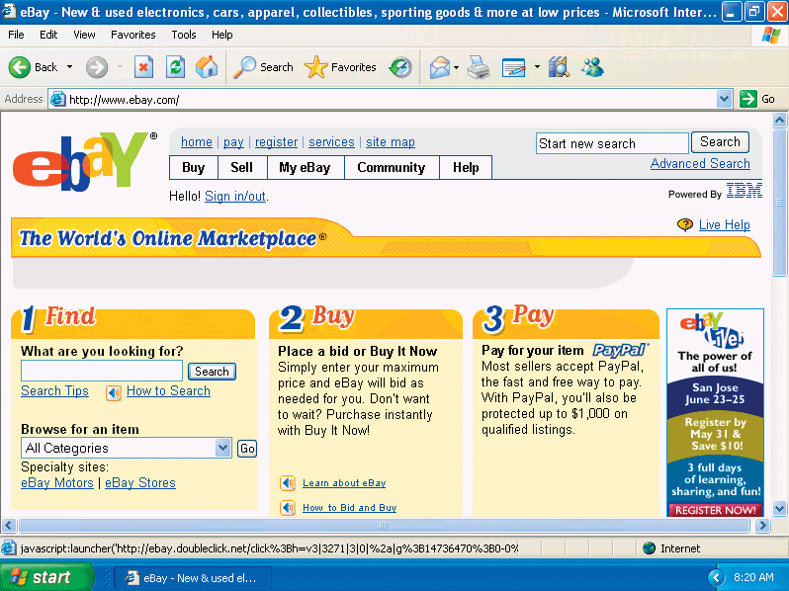
Business
Electronic commerce (e-commerce) is the practice of conducting business activities online, such as shopping
Business-to-consumer (B2C)
Business-to-business (B2B)
Consumer-to-consumer (C2C)

Slide 36
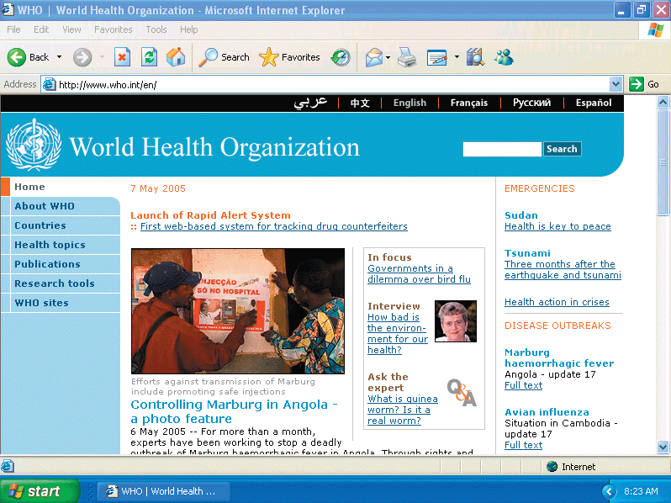
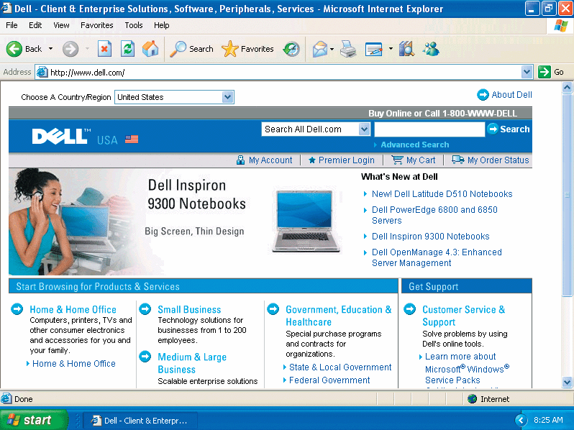
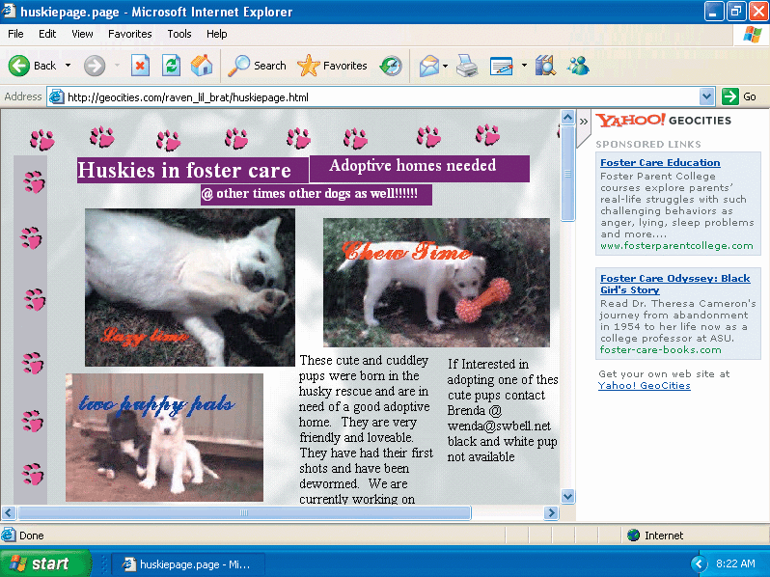
Types of Web Sites
Personal
Organizational / Topical
Commercial

Slide 37
Personal
Limited developmental resources
Uses
Advertise employment credentials
Meet new friends
Share common interests
Do not post information that can be misused

Slide 38
Organizational / Topical
Organization Web sites contain information on particular organizations
Topical Web sites contain information on the developer’s interests and hobbies
Not all information is accurate

Slide 39
Commercial
Used to promote and sell a product for a business via the Internet
More complex commercial Web sites generally produce greater revenue
Obtain product and service information from a company’s marketing department

Slide 40
Researching Web Technologies
What specifically can this technology do to further the purpose of my Web site?
Will it appeal to my audience?
What will it cost to put it into action?
How soon will I see a return on investing in this new technology?
What impact will adding this technology have on security and other Web site elements?

Slide 41
Tools for Creating Web Pages
Hypertext Markup Language (HTML)
eXtensible Markup Language (XML), eXtensible HTML (XHTML), and Wireless Markup Language (WML)
Cascading Style Sheets
Scripting Languages

Slide 42
Hypertext Markup Language
Formatting language used to create Web pages
Defines a Web page through tags or markups
World Wide Web Consortium (W3C) sets standards for HTML and HTTP

Slide 43
eXtensible Markup Language (XML), eXtensible HTML (XHTML), and Wireless Markup Language (WML)
XML uses markups to define the content of a Web page
XHTML is a markup language that is a combination of the features of XML and HTML
WML is a subset of XML
Used to design Web pages for microbrowsers

Slide 44
Cascading Style Sheets (CSS)
Control the presentation of the content by applying styles to such elements
Type
Margins
Positioning
Colors

Slide 45
Scripting Languages
Short programs that your visitors’ browsers run
Browsers must support this technology
Javascript
Active Server Pages (ASP)
Hypertext Preprocessor (PHP)
MySql

Slide 46
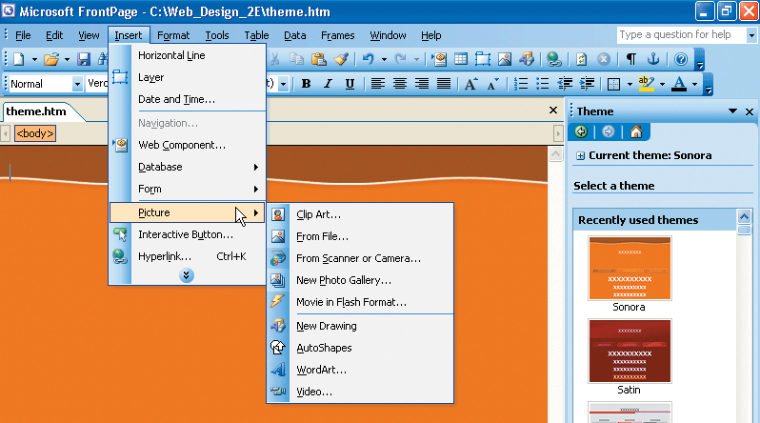
WYSIWYG
Packages that automatically generate HTML code
There are packages available for every level of expertise
Microsoft FrontPage
Macromedia Dreamweaver
Adobe Go Live

Slide 47
Web Design Roles
Web design can be done independently or with a partner or group
Creative Role
Content writer / editor
Web page designer
Web artist / graphic designer
Multimedia producer

Slide 48
Web Design Roles
Hi-Tech Role
Web programmer
Database developer
Network / security administrator
Oversight Role
Content managers
Content management system

